Slide 1


Catch these Poké-Hands
Ian Arch, Paige Breyfogle, Daniel Buescher, Andrew Stepanek

Slide 2
Previously On “Pokémon: Gotta graph em all!”
Expanded on previous dataset

Slide 3
Gameplan
Goal: Expand on the data from our prior project and create a Machine Learning algorithm to predict the winner of a fight based on stats, also have an ML algorithm to predict a Pokémon’s type based on stats
“Everyone has a plan, until they get punched in the mouth”- Iron Mike Tyson
These are the snags/problems that we encountered along the way

Slide 4
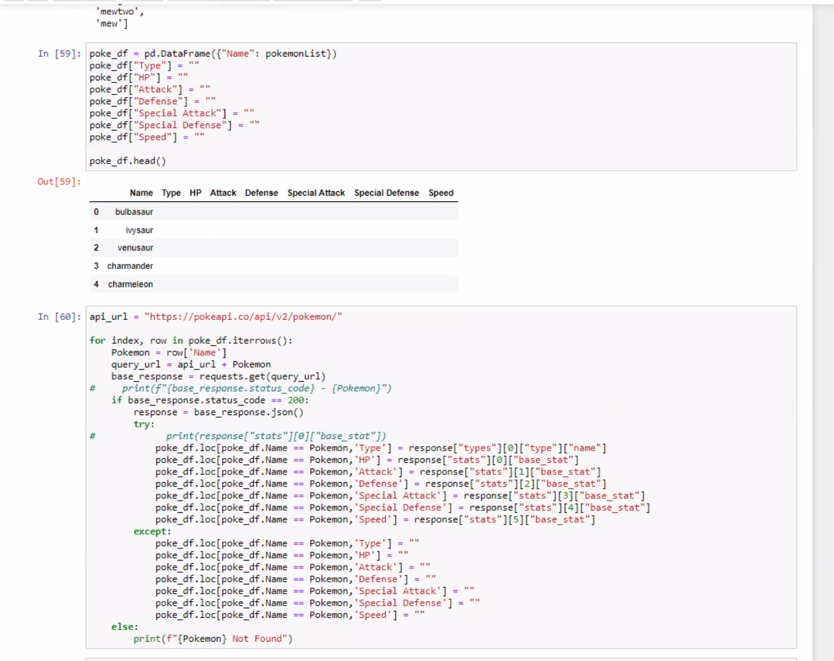
Process
We expanded on a previous dataset

Slide 5
Process

Slide 6
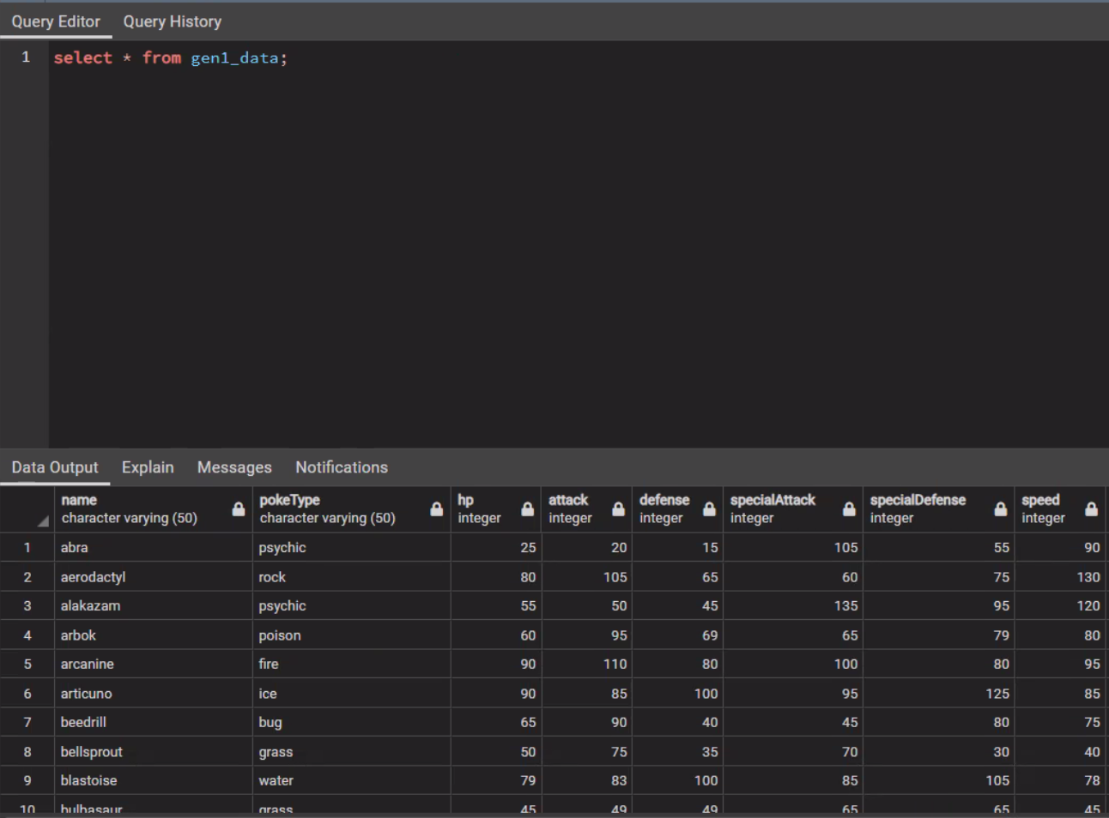
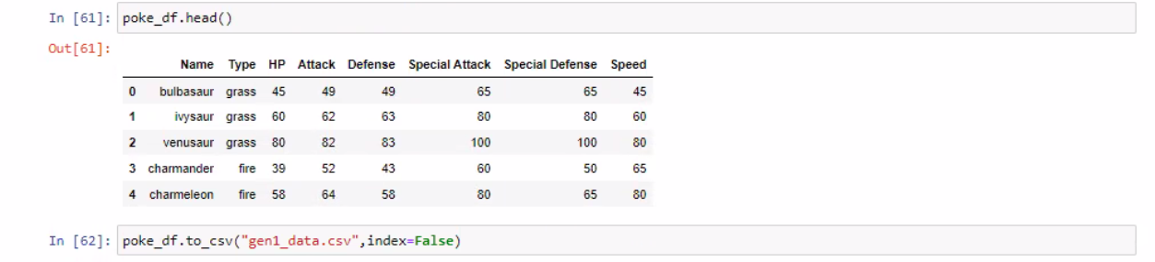
Process

Slide 7
Machine Learning

Slide 8

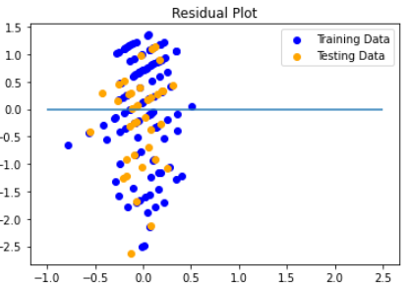
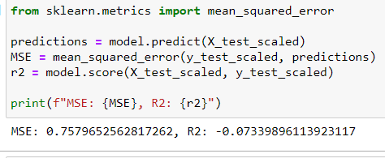
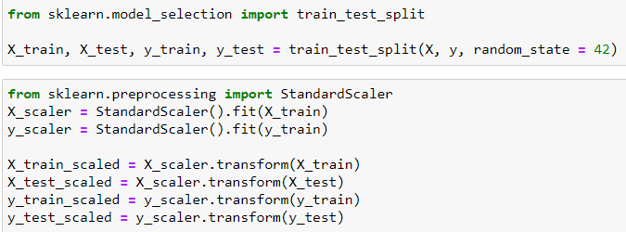
Machine Learning
ML algorithm to predict type based on inputted stats
Types are not defined by stat thresholds

Slide 9
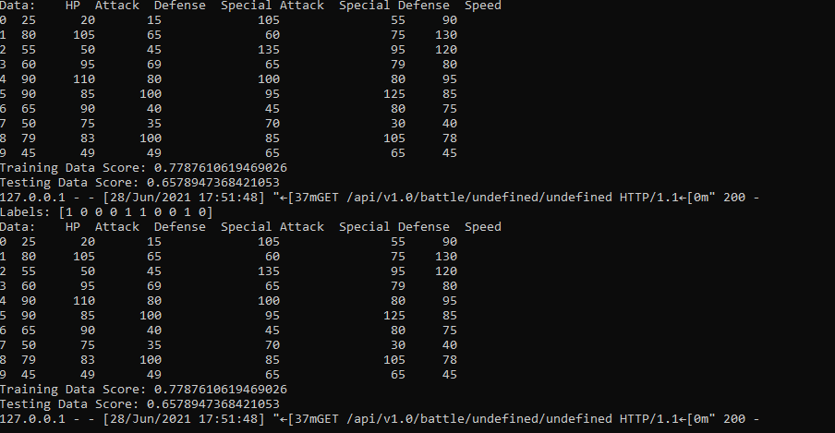

Lost Battles Trials & Tribulations

Slide 10
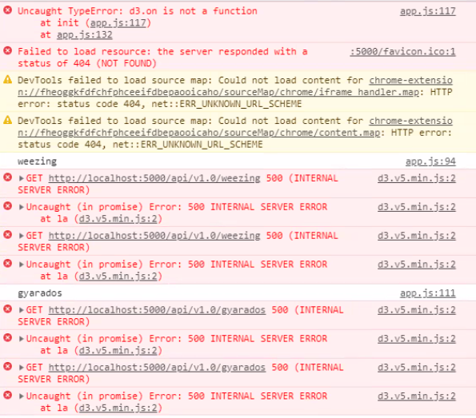
Lost Battles Trials & Tribulations

Slide 11
Lost Battles Trials & Tribulations
Design
Something we

